Slide 1


Extending Allotrope: An Ontological Representation and Analysis of
Process Chemistry
Oliver He, Wes Schafer
Notes:
We appreciate the opportunity given to us to present our work. It’s a collaborative work between UM and Merck. The title of our talk is: “...”

Slide 2
Outline
Acknowledgements
The Importance of Context
The Scope of Process Chemistry
Survey of Existing Ontologies and Terminologies
Proposal for Process Chemistry Ontology
OPC development strategy and methodology
Upper level hierarchy and design patterns
2 Use Cases
Fate and purge
DoE: Design of Experiment
Example OWL Definitions
Summary & Discussion
Notes:
Here is the outline. First, …

Slide 3
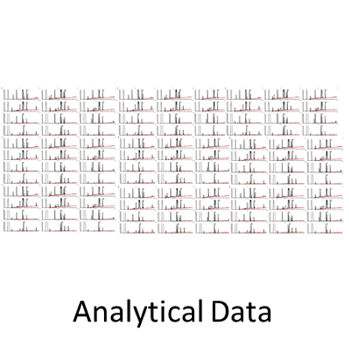
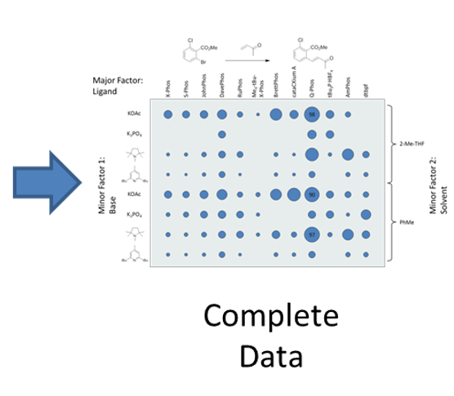
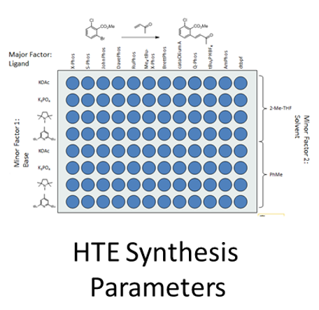

The Importance of Context
e.g., mining analytical parameters as a function of synthesis parameters across experiments
e.g., mining synthesis parameters across experiments
e.g., mining analytical parameters across experiments
Experimental and workflow details need to be linked to the analytical data in order for it to have context and to enable data mining.
We need the language to do this.
Notes:
In many cases, it is not enough to just ask what are the results associated with a given sample ID. To truly enable data mining and artificial intelligence we need to know what the sample represents. What is the compound, what are the conditions that produced the sample? Only then can we draw conclusions based on the analytical data.
In this case we are looking at a catalysis screening experiment, There are two sets of data: the analytical data for each well and the experimental data that includes the reactants etc. By combining the data you can determine what the best catalyst and best solvent is. Otherwise you only know that wells A-9 E-9 and G-9 have the highest amount of desired product.
The purpose of this work is to standardize how we represent those experimental parameters.

Slide 4
Ontology Terms Provide Entry-level Standardization
Implementable for systems not semantically enabled.
Provides standardized data labels
Still provides link to enduring definitions and machine-readable semantics
System 2
Batch
001J013
001J014
System 2
batch identifier
001J013
001J014
System 1
Lot
001J013
001J014
System 1
batch identifier
001J013
001J014
preferred label "batch identifier"
definition "The batch identifier is measurement metadata that identifies the batch where a sample is taken from for being measured. [Allotrope]“
Semantic Definition (machine readable)
Subclass of identifier
and 'measurement metadata'
and (identifies some entity ('has role' some 'batch role'))
Public reference:
http://purl.allotrope.org/ontologies/result#AFR_0001120
System 3
Lot ID
001J013
001J014
System 3
batch identifier
001J013
001J014
Notes:
The scenario on the left is all too common. Three different systems all use different terms for the exact same concept making it difficult to join and compare the data. This along with typos, abbreviations are major headaches requiring data scrubbing before we can actually assess and interpret our data.
Agreeing on terms is the easiest entry point for standardization. Although semantically enable systems are of the highest value, ontologies already assist in data management for systems that are not semantically enabled. Standard terms facilitate data aggregation and the associated semantic definition enable machine learning.

Slide 5
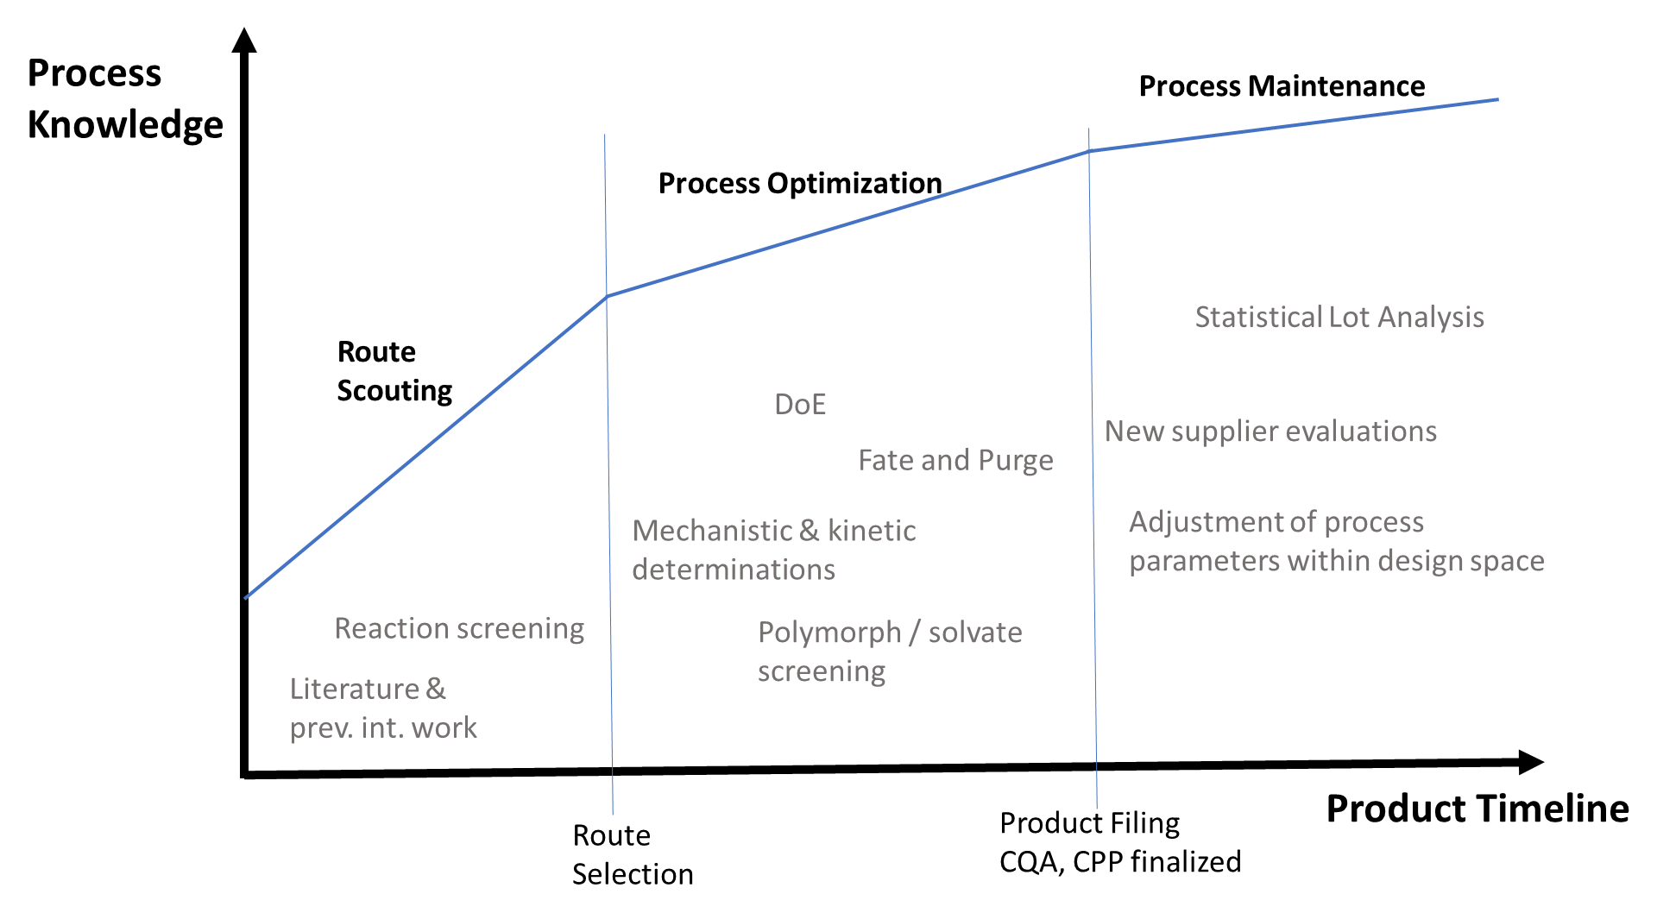
Process Chemistry Lifecycle
Notes:
As the title states this talk is about building an ontology to describe Process chemistry. Process chemistry is about the development of a sustainable, economical synthesis for clinical and commercial purposes. As opposed to discovery /or medicinal chemistry where the emphasis is on quickly generating a diverse set of molecules, process chemistry focuses on cost, throughput / processability and environmental impact of a particular compound, Process chemistry activities can be divided into three categories: route scouting, process optimization and process maintenance. Route scouting is proposing and evaluating different synthetic routes. Literature searches and reaction screening are examples of activities in this phase. Process optimization is optimizing the most promising routes identified. Here in-depth studies around mechanism, processability as well as impurity tracking. Finally process maintenance makes further refinements in the actual plant setting as well as addressing any unforeseen issues.

Slide 6
Survey of BFO (OBO) Ontologies for Process Chemistry Terms
Domain | Ontology | Application to process chemistry
Top level ontology | BFO (Basic Formal Ontology) | Aligns other ontologies together
Relations | Relation Ontology (RO) | Provides standard commonly used relations
Information | Information Artifact Ontology (IAO) | Provides general information-related terms
Lab measurements | OBI (Ontology for Biomedical Investigations) | Describe laboratory values related to patient diagnostics
Chemical compounds | ChEBI (Chemical Entities of Biological Interest) | Describe metabolites and other chemical entities
Chemical methods | CHMO | https://www.ebi.ac.uk/ols/ontologies/chmo
Organic reactions | RXNO | Name reactions in chemical processes
Units | UO | Units used in chemical processes
Drugs | DrON (Drug Ontology) | Describe patient medications
Proteins (e.g., enzymes) | PRO (Protein Ontology) | Describe protein-related entities and the relations between these entities
No full BFO ontology for the domain of process chemistry exists.
Notes:
The Open Biomedical/Biological Ontology (OBO) Foundry is an open source ontology community with the ultimate goal to built up a set of non-redundant interoperable ontologies in the biomedical and biological fields. There are approximately 200 OBO reference ontologies nowadays. The first thing we did was to check the OBO ontologies and see if there are any OBO ontologies related to process chemistry. As seen in the Table, there are many OBO ontologies that target on specific aspects that are somehow related to process chemistry. For example, chemical compounds, chemical methods, drugs, proteins, etc. however, there is no single ontology that is purely focused on process chemistry.

Slide 7
Survey of Vocabularies in Process Chemistry
Two Process Chemistry Vocabularies
Pistoia (formally Elsevier) Unified Data Model (UDM) - Storage and exchange of experimental information about compound synthesis and testing.
ISA-88: a standard that addresses batch process control (https://en.wikipedia.org/wiki/ISA-88)
Several ontology publications in process chemistry
E.g., overview of chemical ontologies: https://arxiv.org/abs/2002.03842
Overall, good introduction and suggestions, but no solid development.
Allotrope Foundation Ontologies (AFO):
AFO covers some results pertinent to process Chemistry (http://docs.allotrope.org/).
AFO/AFM covers derivatization which parallels organic synthesis.
Our thorough survey found no complete ontology(ies) that focus on the domain of process chemistry, a major branch of pharmaceutical chemistry.
Notes:
Furthermore, we made another survey to go beyond ontologies. We surveyed all the vocabularies and terminologies in Process Chemistry. There are two process chemistry vocabularies …. There are also several publications …
Furthermore, we analyzed Allotrope Foundation Ontologies (AFO): …
Therefore, ….

Slide 8
Proposal of OPC: “Ontology of Process Chemistry”
A new ontology, OPC with the focus on the domain of process chemistry.
OPC covers the entire timeline from route scouting to reaction optimization to process maintenance.
Example components of the proposed OPC:
Reaction kinetics and mechanism (incl stoichiometry)
Polymorphism, solvates
Additional material roles (surfactants, flocculants, etc.)
Key reaction types: additions, eliminations etc. (coverage by REAXNO)
Unit operations such as filtering, refluxing etc.
Filings
Notes:
As a result, we propose to develop OPC: “Ontology of Process Chemistry”. ...

Slide 9
OPC development strategy and methodology
eXtensible ontology development (XOD):
Term reuse, alignment, design pattern, and community extensibility
OBO Foundry ontology development principles
Allotrope style guide
Up-down design:
OPC aligns with the Basic Formal Ontology (BFO).
Bottom-up design:
Common operations, basic reaction pattern (implied by ADM)
Use cases based on workflows (often required by regulatory agencies).
Notes:
The OPC development will follow a strategy called eXtensible ontology development (XOD) that is a well acknowledged ontology development strategy we proposed two years ago. Specifically, … …

Slide 10
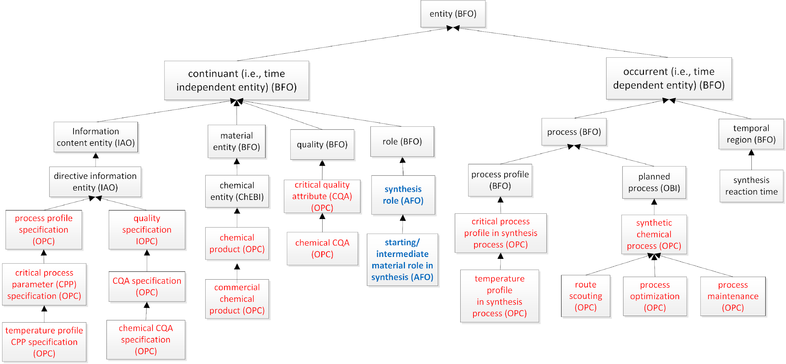
Top-Down: Define Upper level of OPC
Align with BFO
Notes:
Here is the high level top-down ontology design. Specifically, …

Slide 11
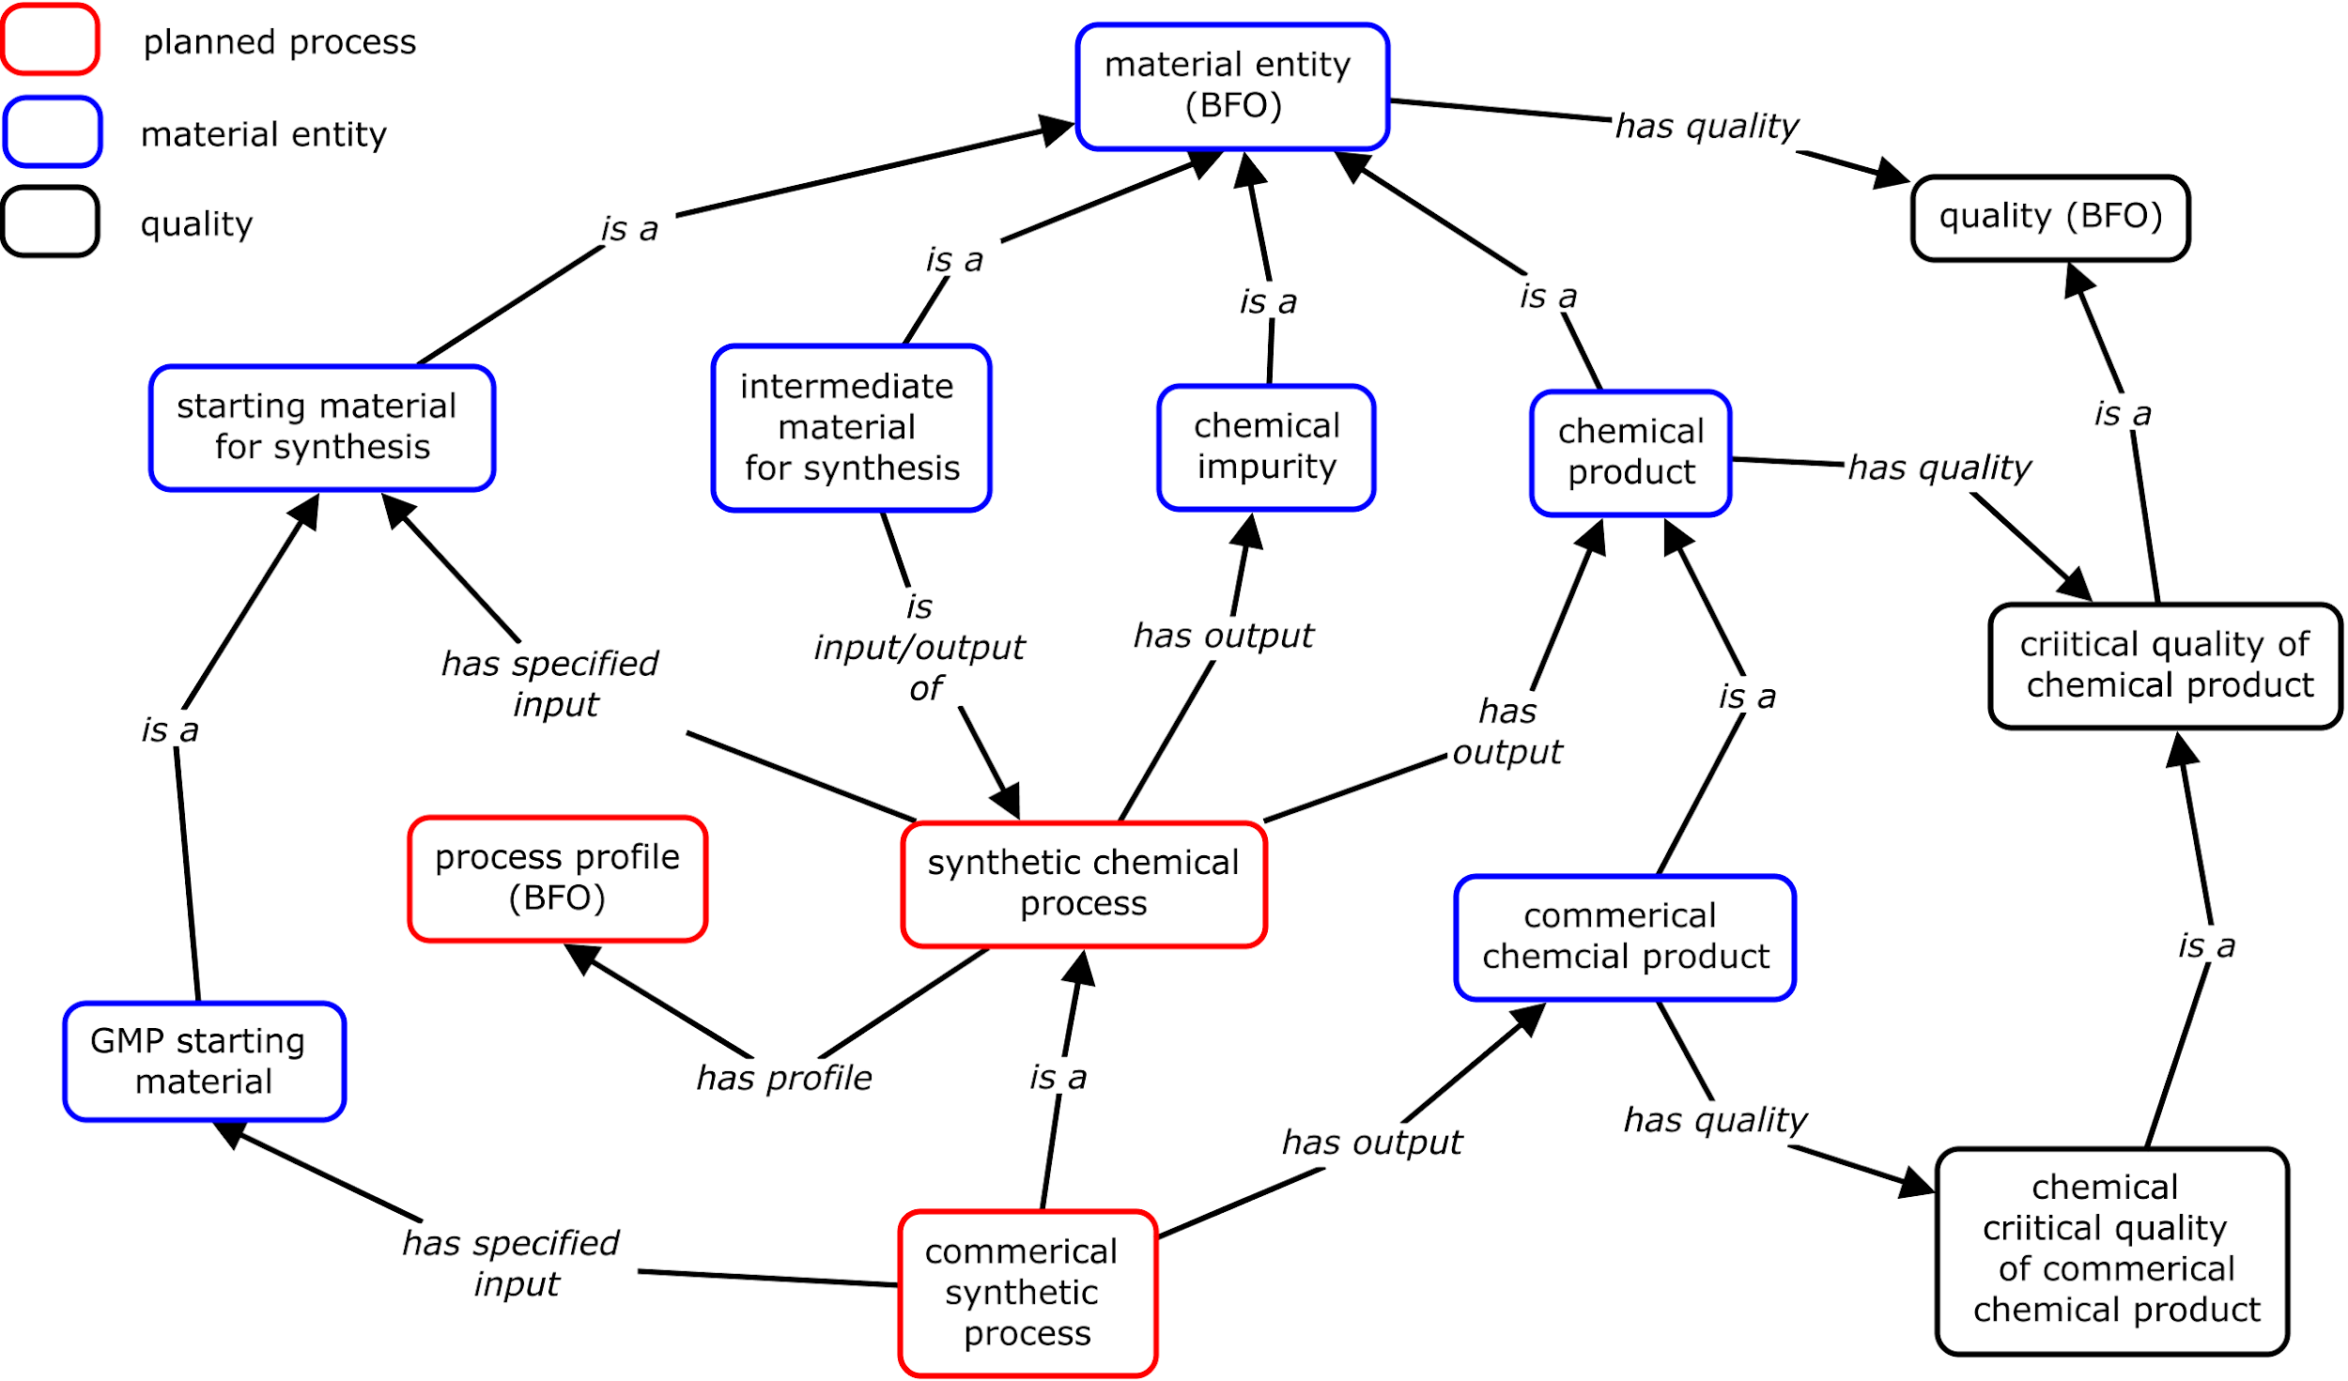
OPC design pattern for a chemical process
BFO compliant, consistent with AFO
Notes:
Here is a more specific OPC design pattern for a chemical process. Specifically, …

Slide 12
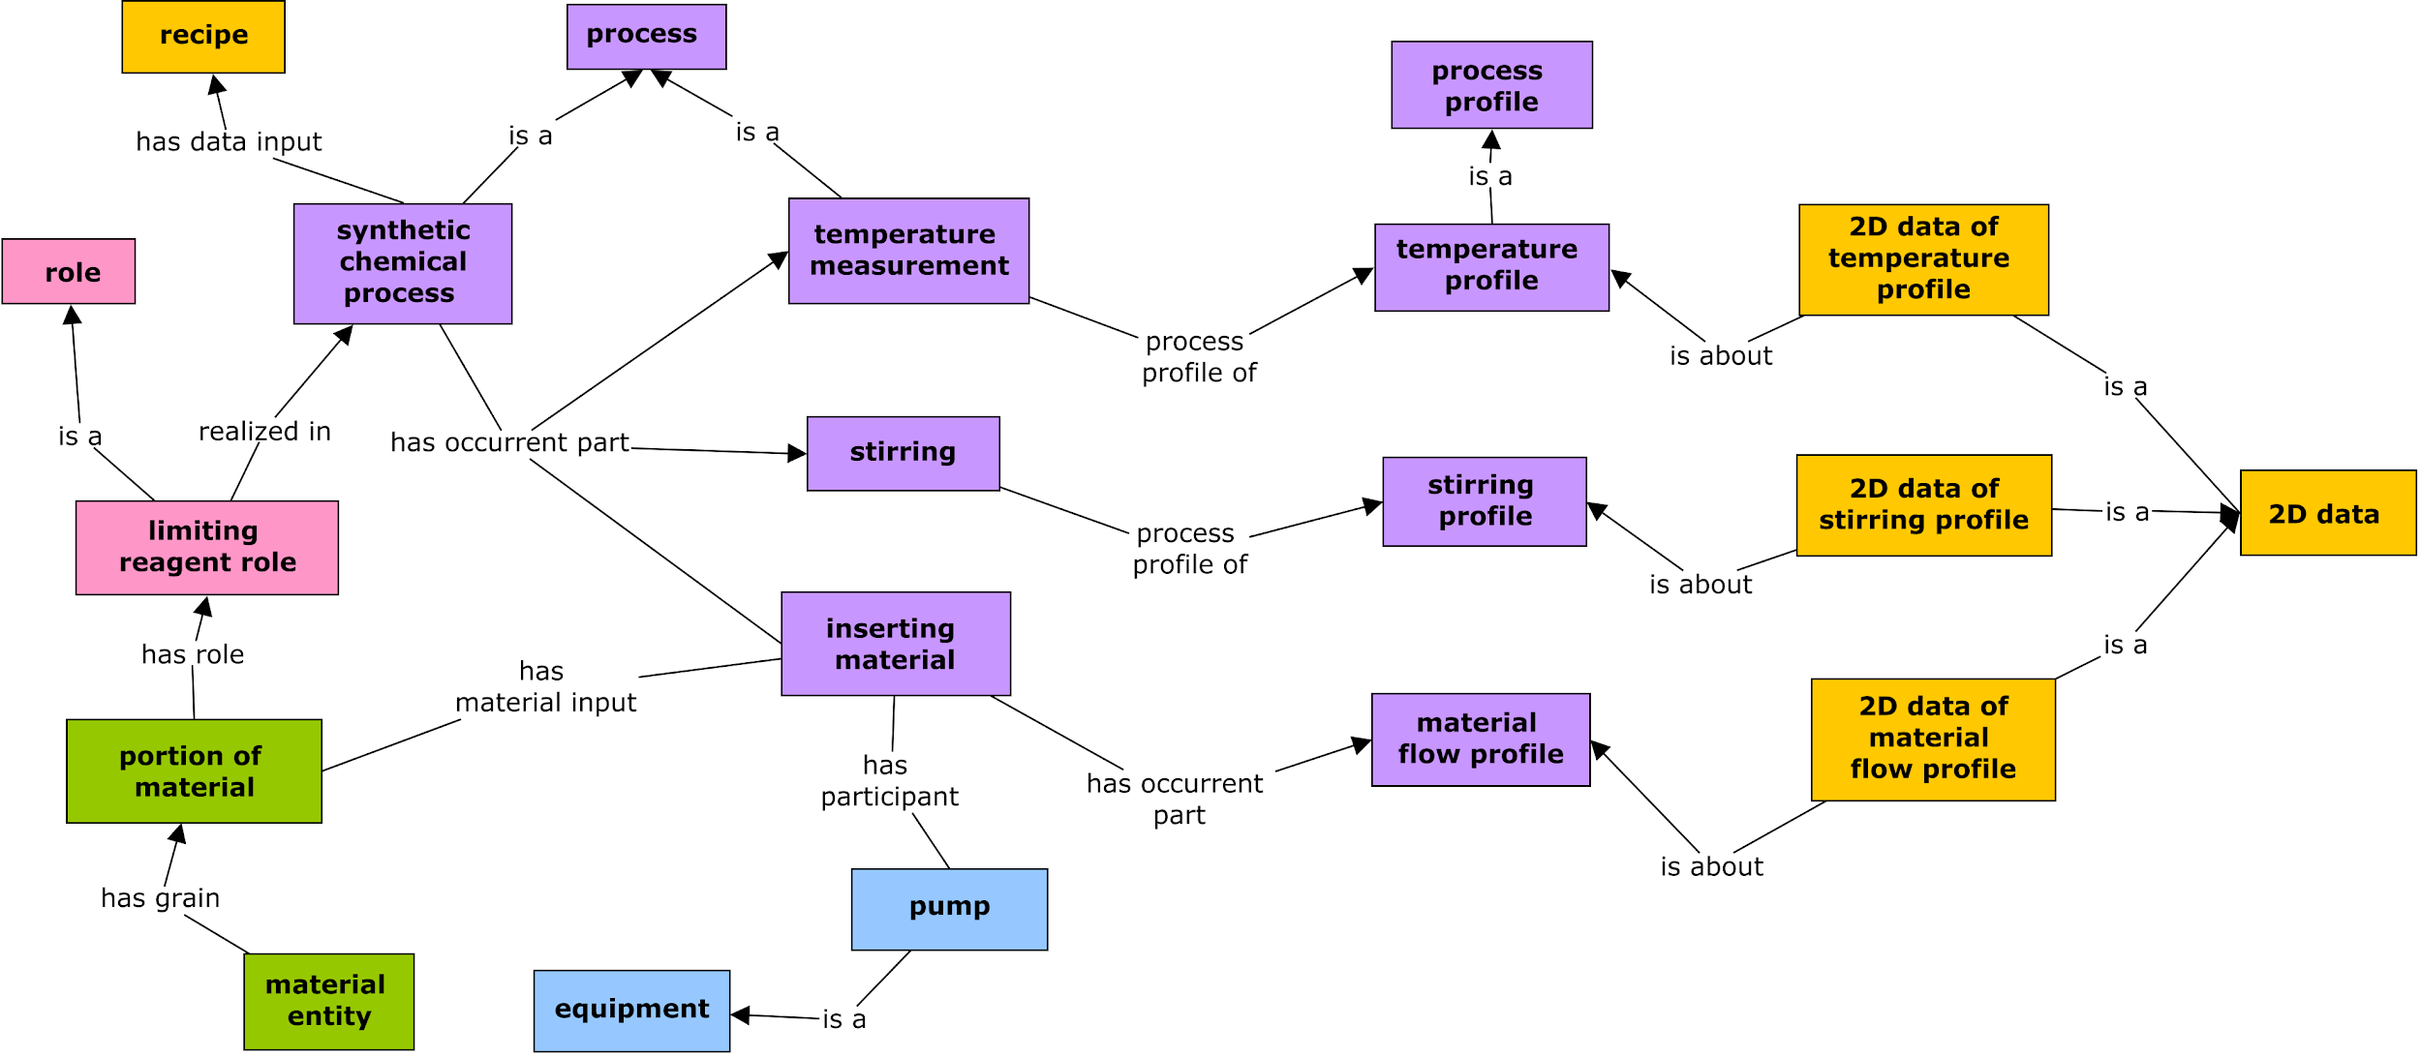
OPC unit operation processes detail syntheses
Leveraging existing vocabularies (ontologies when available)
More unit operations: crystallization, salt formation, pH adjustment, etc.
Notes:
This is the modeling of OPC unit operation processes detail syntheses (???). Specifically, …

Slide 13
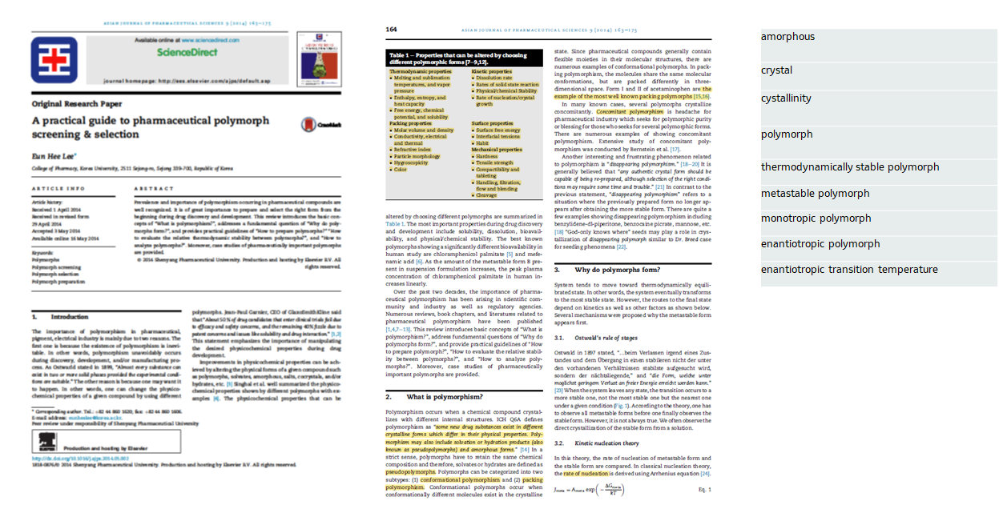
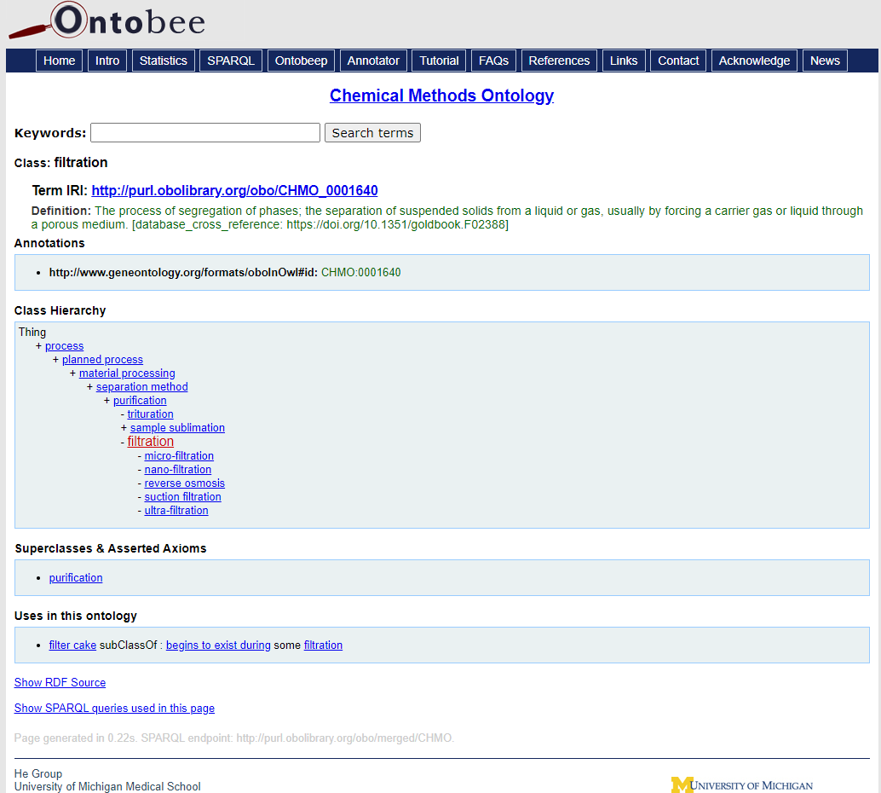
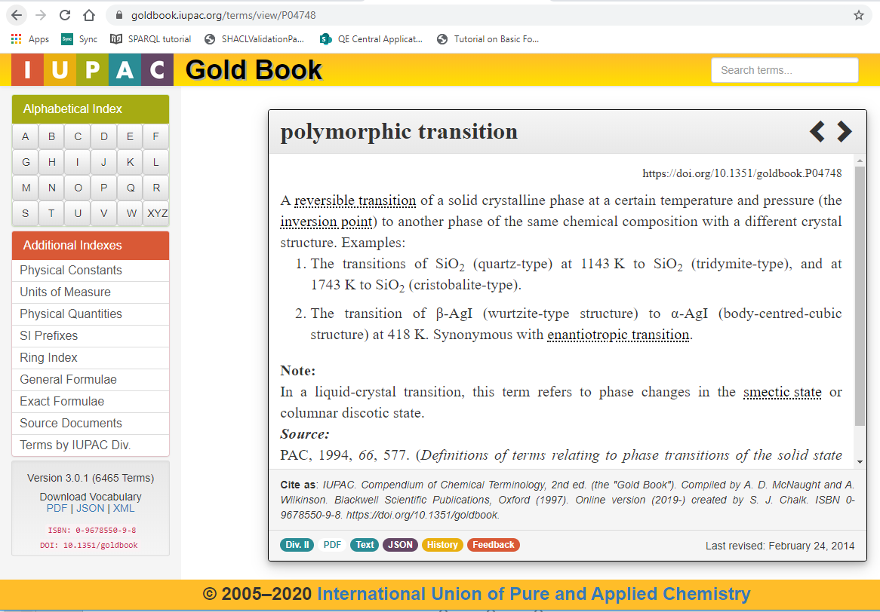
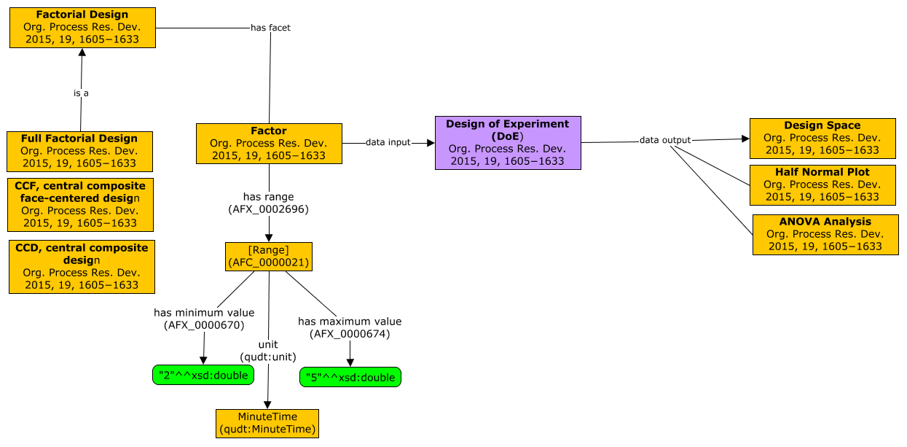
Vetting Workflows - Bottom-Up General Process
Engage SME’s: identify key published material to avoid proprietary issues.
Parse terms from articles (2-4).
Survey existing terms (OBO Foundry, AFO, IUPAC) / identify gaps.
Build “scaffold” CMAP to facilitate ontology development (OWL definitions)

Slide 14
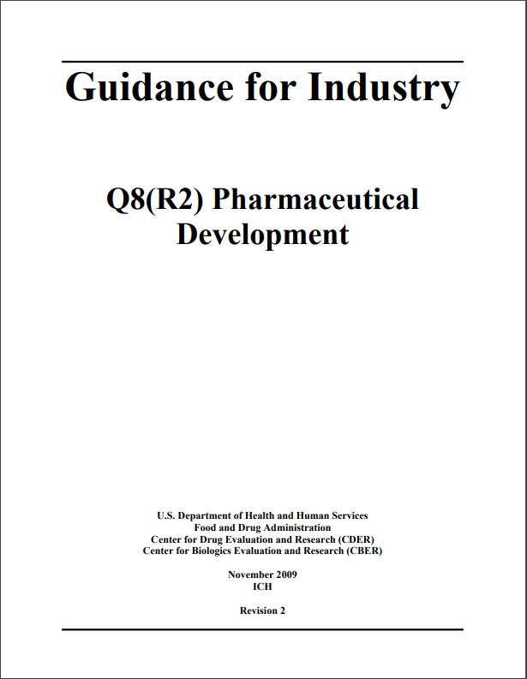
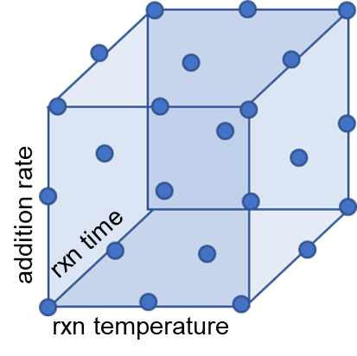
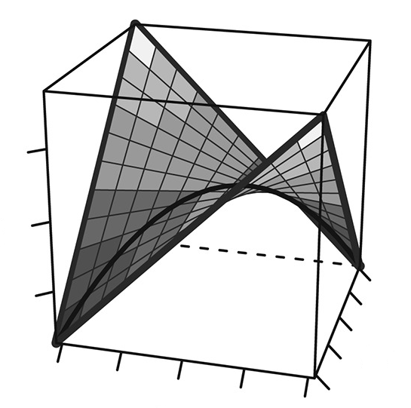
Use Case 1: DoE Studies
“Quality by Design (QbD): A systematic approach to development that begins with predefined objectives and emphasizes product and process understanding and process control, based on sound science and quality risk management.”
e.g. Allotrope PAT and chromatography models
Factorial Design
Multi-dimensional approach to
understanding key factors / variables and their interdependence
Response Curves
aggregate experimental meta data with analytical (instrument) results to enable decision making (design space).
DoE Study Implementation
Objective Definition
Factor and Range Definition
Response Definition
Experimental Data Collection
Data Analysis
Confirmatory Reactions
Variable interactions can be modeled by graphs
A_{i}i + A_{j1j2}j+ A_{f(k1,k2)}k
area percent -> conversion
rxn time
rxn temperature

Slide 15
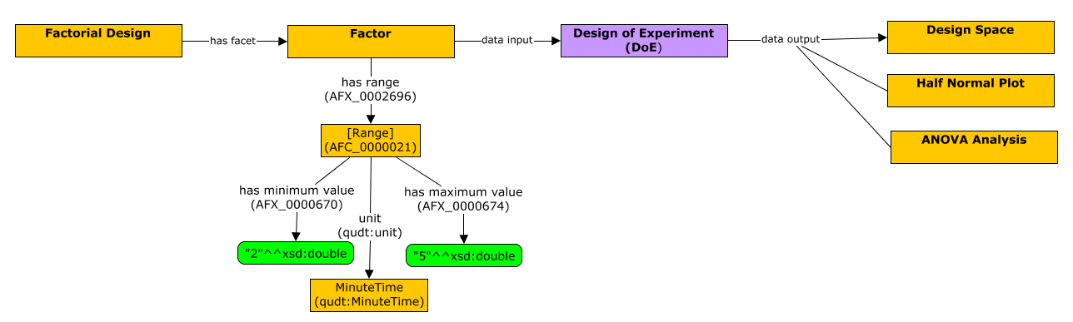
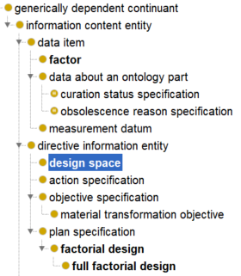
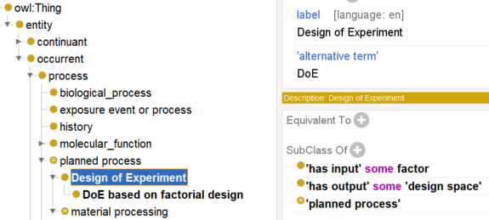
Example terms from Use Case 1: DoE Studies

Slide 16
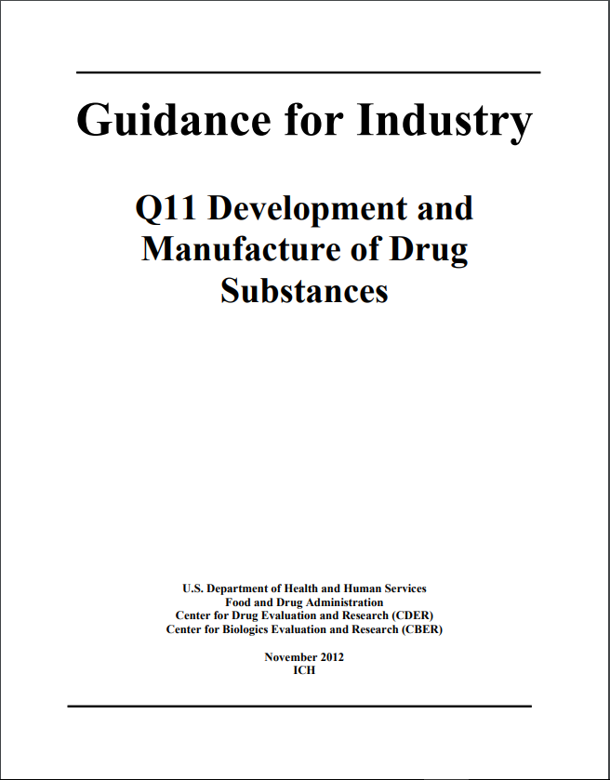
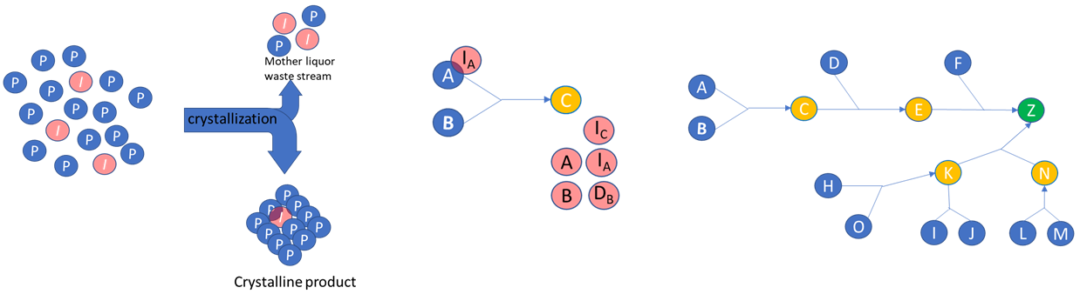
Use Case 2: Fate and Purge Studies
“It is important to understand the formation, fate (whether the impurity reacts and changes its chemical structure), and purge (whether the impurity is removed by, for example, crystallization, extraction), as well as their relationship to the resulting impurities that end up in the drug substance as CQAs”
e.g. Allotrope chromatography and SQD models
Analytical analyses of process streams determines purge factors of individual steps
Aggregation of experimental data tells the whole story of the ultimate fate of impurities and overall purge factors
Impurity Purging by Simple Crystallization Process
Unreacted reagents, reaction by-products
and degradation of impurities complicate fate analyses
Complicated Synthetic Processes push the capabilities of relational models (Graphs are Scalable)

Slide 17
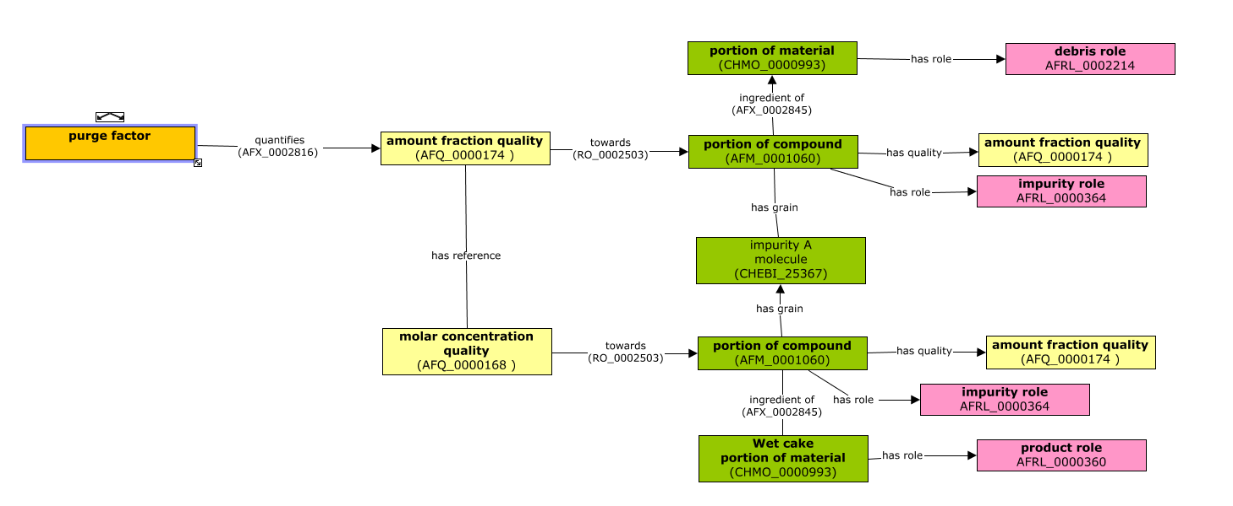
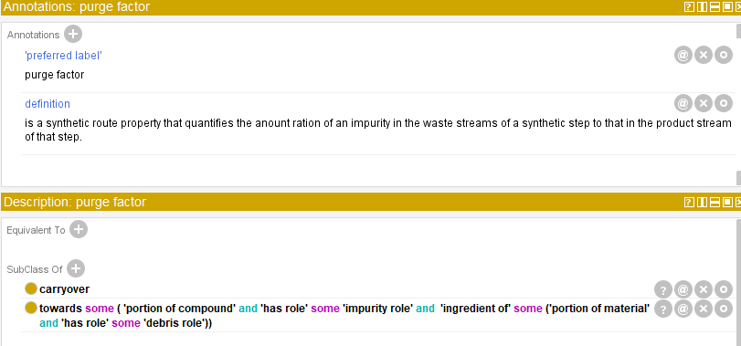

Example terms from Use Case 2: Fate and Purge Studies
Purge Factor
Overall Purge Factor
Carryover
Cumulative Carryover

Slide 18
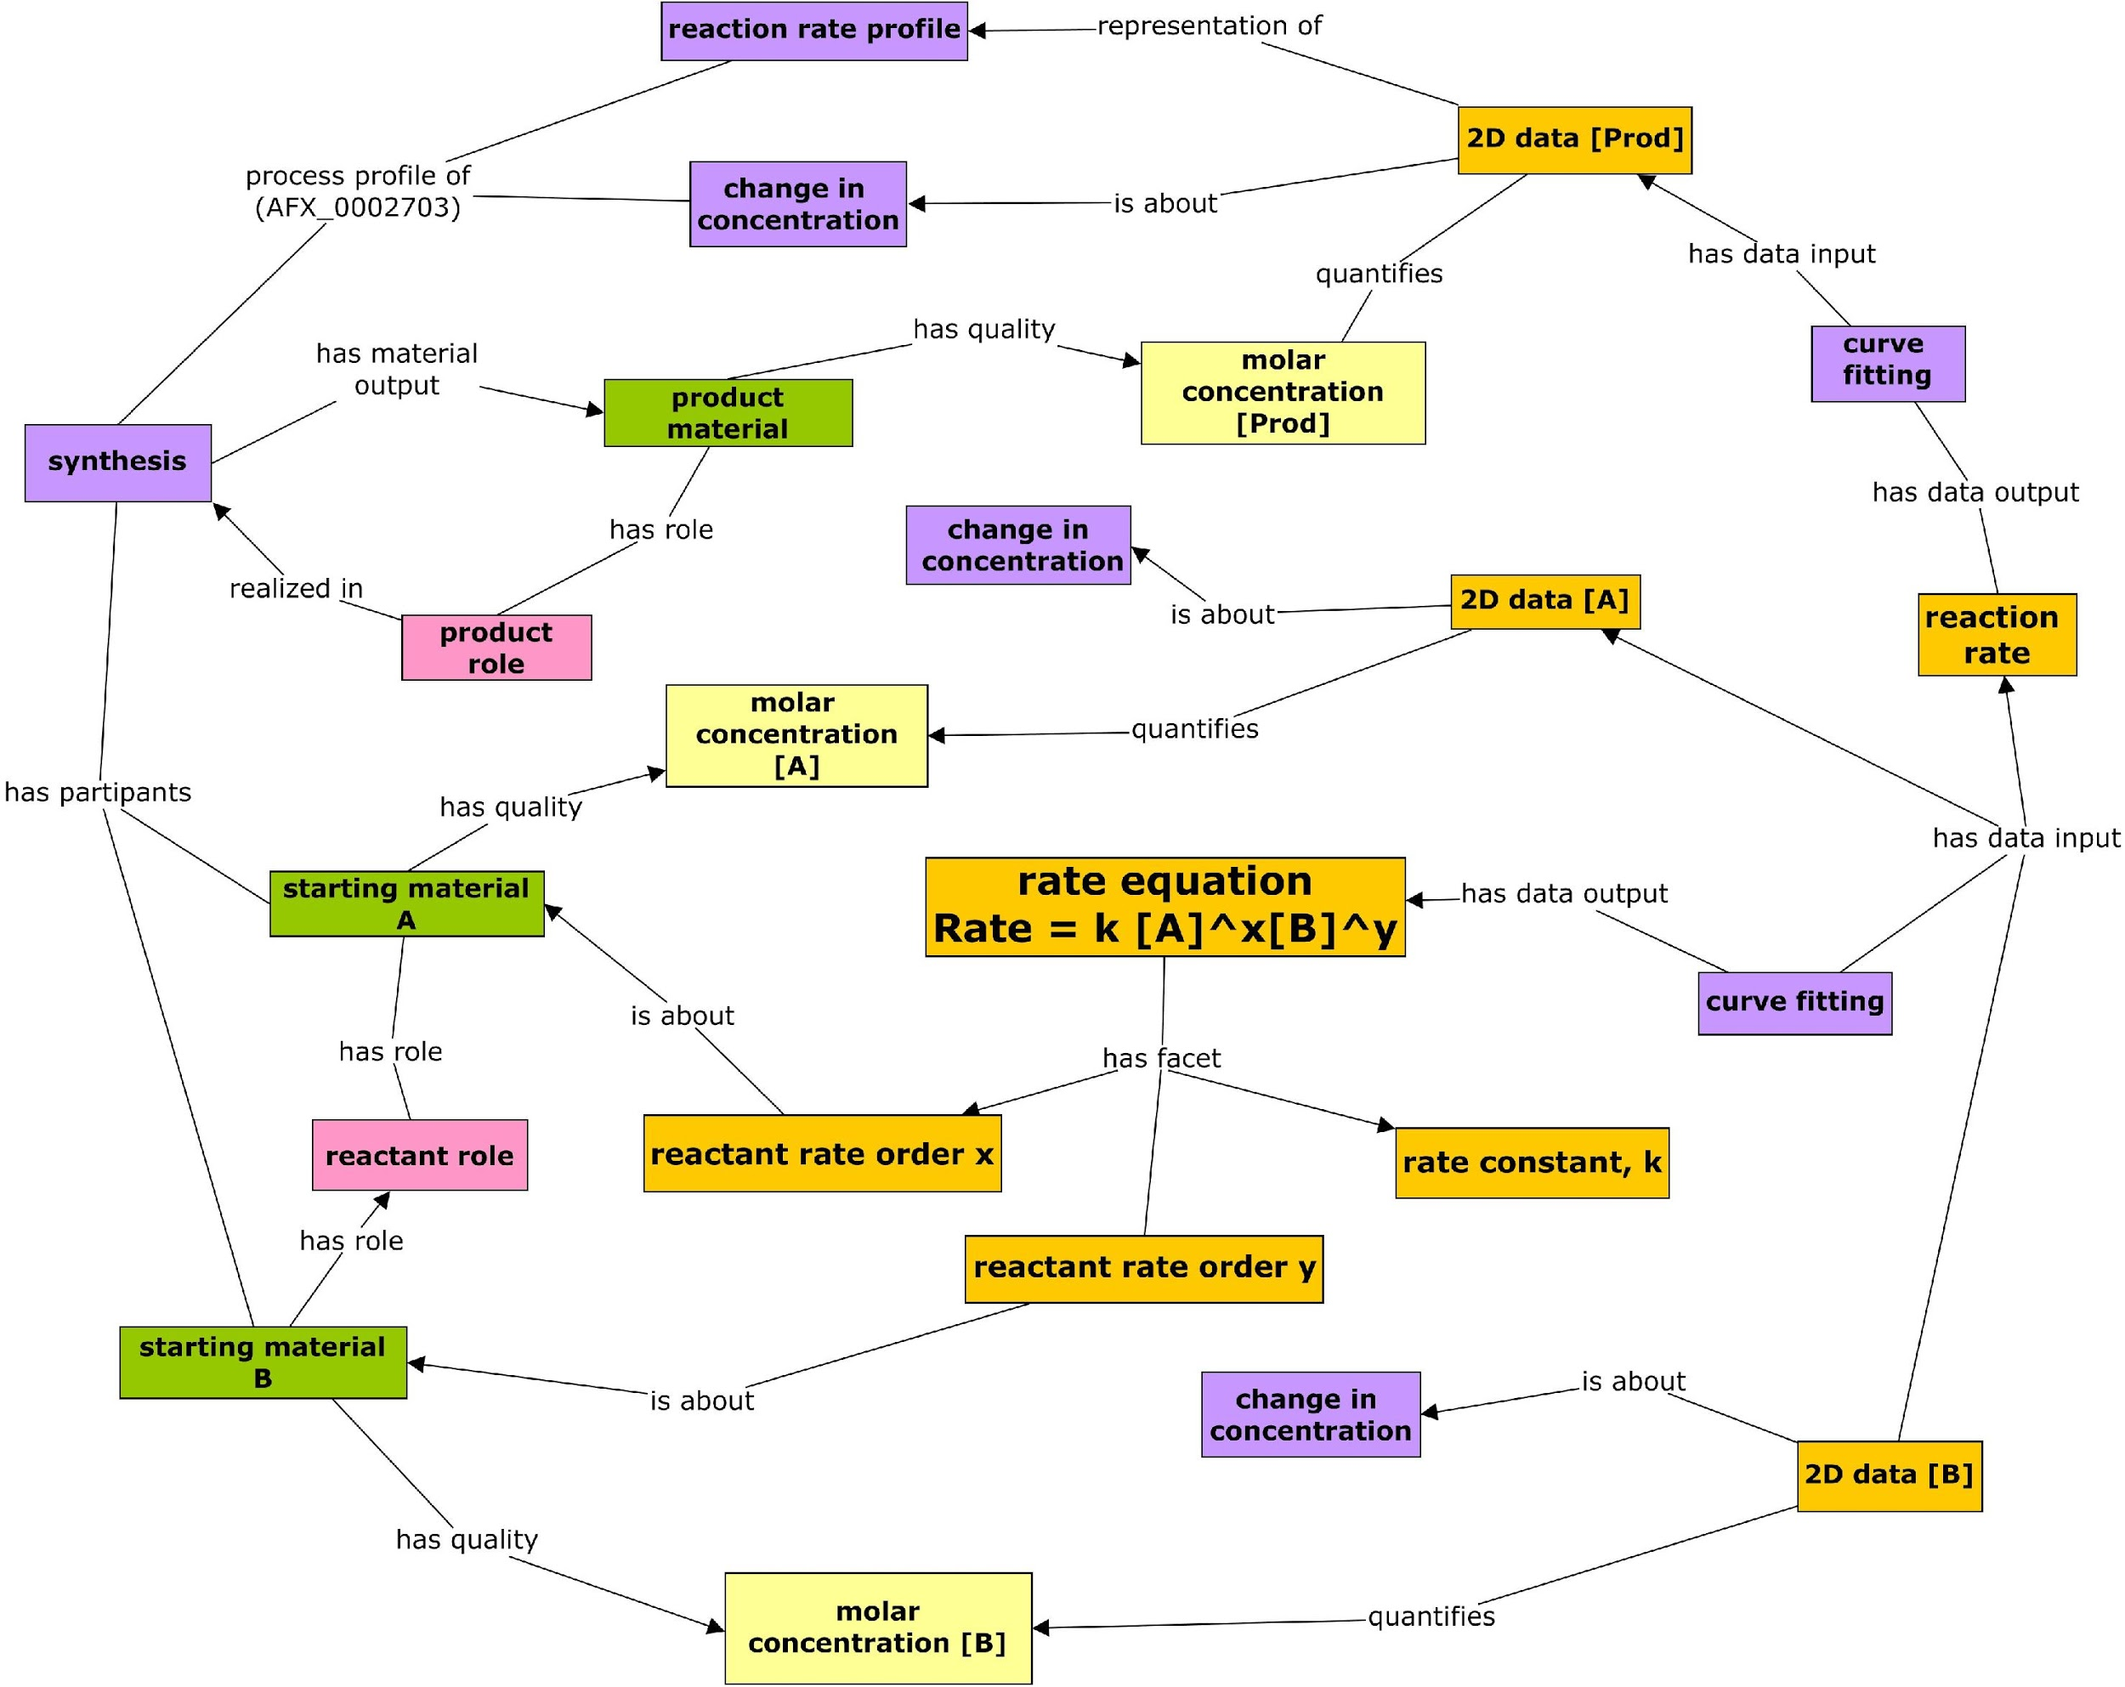
“Pressure Test”: Does Ontology Support Reaction Kinetics?
Modeling of a reaction that has two input materials A and B. The reaction rate kinetics formula is then:
Reaction Rate = k [A]^{x}[B]^{y}
The values including A molar concentration [A], B molar concentration [B], and molar concentration of the output product will be measured
Rate equation
Rate = k[A]^{x}[B]^{y}
Notes:
Although this is an ontology project only, we did want to test if the ontology would support ADM-like model development. Here we used a third use case, reaction kinetics as a test. The proposed kinetic terms were able to describe a rate equation and the associated kinetic parameters in a BFO compliant model.

Slide 19
Summary & Discussion
Summary:
A thorough survey on process chemistry ontology
A new OPC proposed
OPC development strategy, method, top-level design, and design patterns
OPC maintains its interoperability with Allotrope ontologies
OPC development just began
Discussion:
OPC could be developed as a standalone ontology and/or become part of Allotrope Ontology.
Are others interested in participating?
The University of Michigan acknowledges financial support from Merck for this collaboration.
Notes:
In summary, today Wes and I presented our recent work. …
Two options: 1. Make it a standalone ontology, meaning that it won’t be governed or released by Allotrope, although every effort will be made to make it fully compatible. The second option is the opposite, to make OPC a domain in AFO, which will be governed or released by Allotrope.
Our timeline of our first release will be the first quarter in 2021.

